Slide 1


Student Database Management System
A Student Database Management System is a comprehensive software solution for managing and organizing student information, courses, and academic records. It streamlines administrative tasks and provides valuable insights for educators and administrators.
by :
U.Gnana Deepika-192210133
P.Nikitha-192224194
GD
Notes:
1

Slide 2
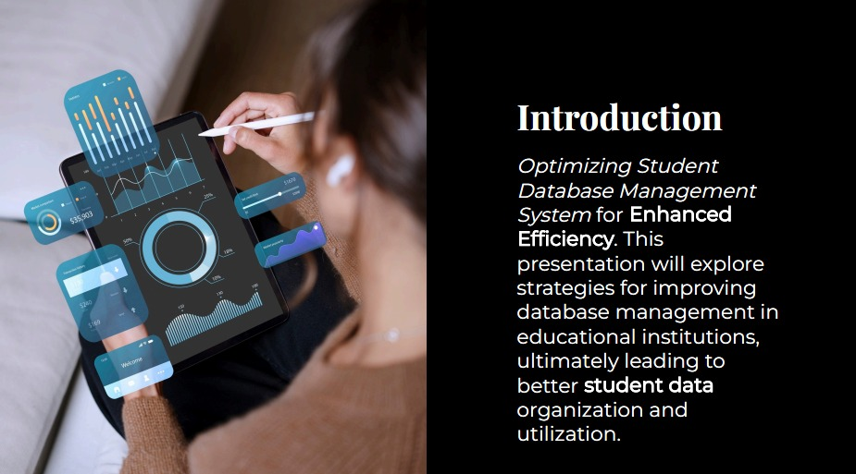

Slide 3

Overview
1
Key Features
2
Benefits
Centralized student information, course management, attendance tracking, grading, reporting, and communication tools.
Improved efficiency, enhanced data accuracy, better decision-making, improved communication, and reduced administrative burden.
3
Target Users
4
Technology
Schools, universities, and educational institutions of all sizes, from primary schools to large universities.
Modern web-based platforms with a user-friendly interface, robust security features, and integration capabilities.
Notes:
3

Slide 4
User Roles and Permissions
Administrators
Teachers
Students
Full access to the system, including data management, user administration, system configuration, and reporting.
Access to student information, course materials, attendance records, grades, and communication features.
Access to their own academic records, course information, grades, and communication tools.
Notes:
4

Slide 5
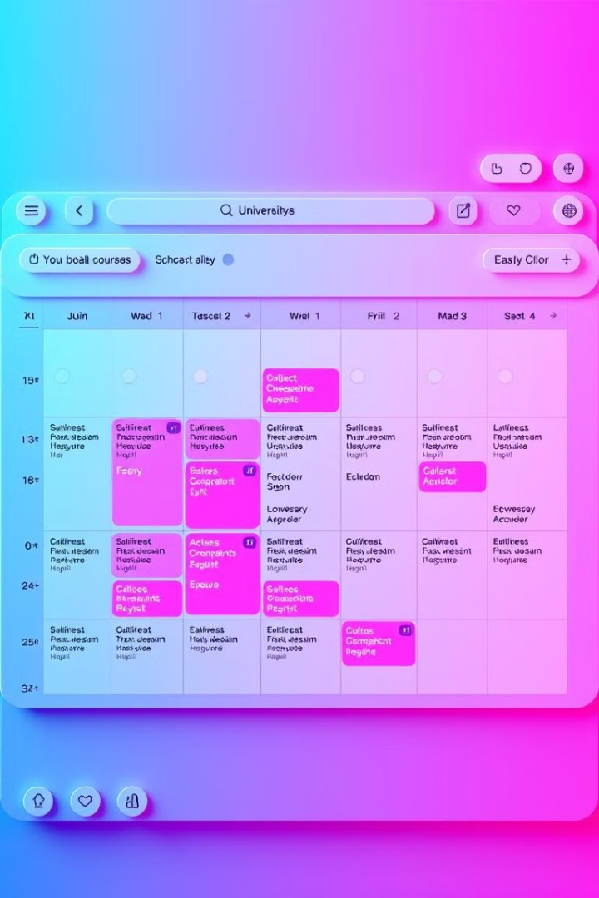
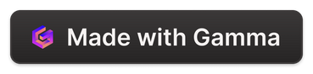
Course and Enrollment Management
1
Course Creation
Adding new courses with details like course name, description, instructor, schedule, syllabus, and learning materials.
2
Enrollment Process
Managing student enrollment, tracking waitlists, and handling course registration deadlines.
3
Section Management
Creating and assigning students to different course sections, managing section changes, and tracking attendance.
4
Course Scheduling
Creating and managing course schedules, including class times, locations, and instructors.
Notes:
5

Slide 6
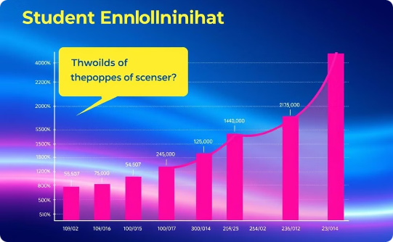
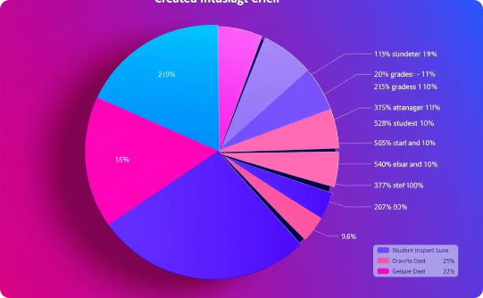
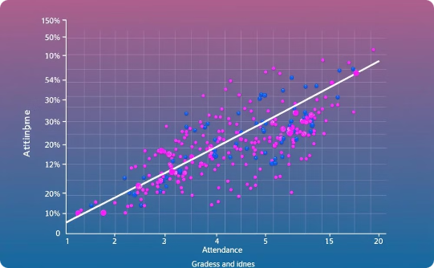
Data Analytics and Reporting
Enrollment Trends
Performance Analysis
Attendance and Grades
Analyze enrollment patterns over time to understand student interest and adjust course offerings accordingly.
Identify areas where students struggle and develop strategies to improve academic performance.
Analyze the relationship between attendance and student grades to identify potential interventions.
Notes:
6

Slide 7
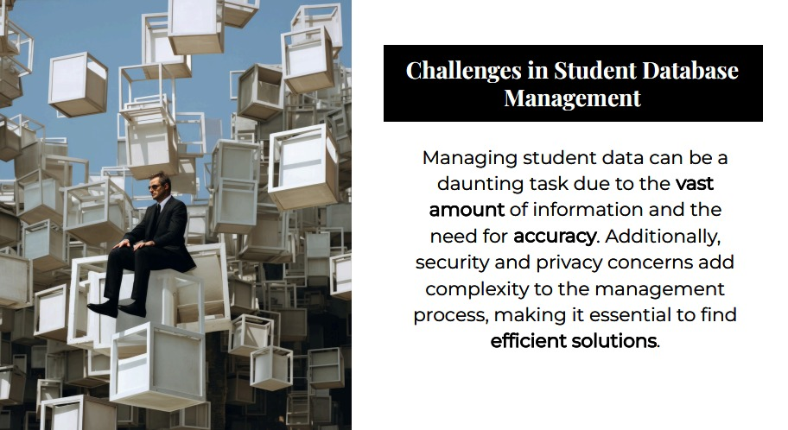

Slide 8
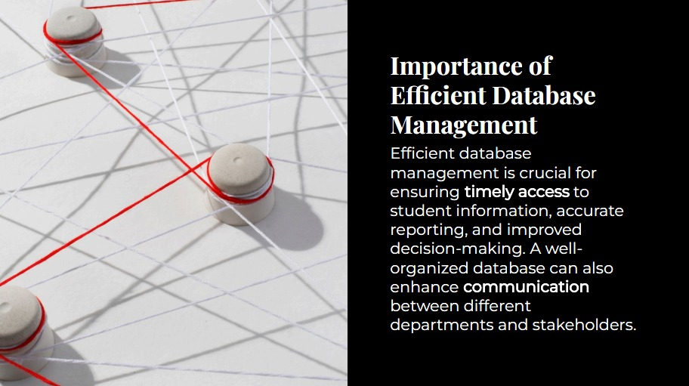

Slide 9
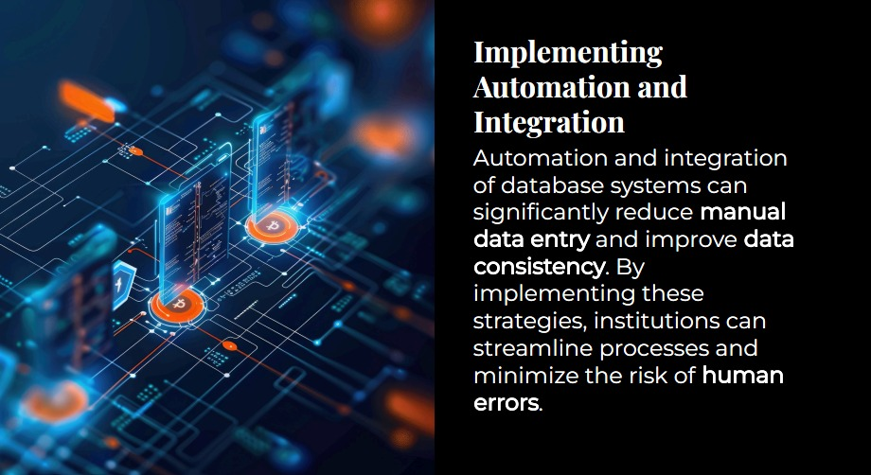

Slide 10


Slide 11
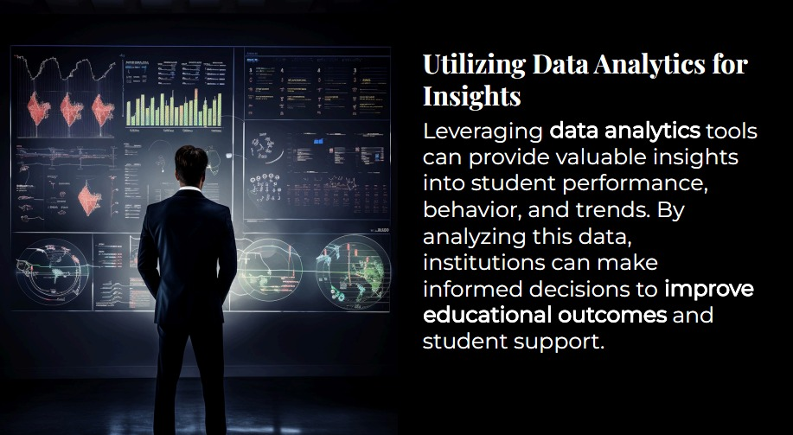

Slide 12
PSEUDO CODE FOR STUDENT DATABASE MANAGEMENT SYSTEM
class Student:
attributes: name, roll_number, marks[3], average, grade
function calculate_average_and_grade():
average = sum(marks) / 3
if average >= 90: grade = "A"
else if average >= 75: grade = "B"
else if average >= 50: grade = "C"
else: grade = "D"
class StudentDatabase:
list students
function add_student(name, roll, marks[]):
create student with details
calculate_average_and_grade()
add student to list

Slide 13
function display_all_students():
for each student in list: print details
function search_student(roll):
for each student in list:
if student.roll_number == roll: return student
return null
function update_student(roll, new_name, new_marks[]):
student = search_student(roll)
if student: update details and calculate_average_and_grade()
function delete_student(roll):
remove student with roll from list
main():
loop until exit:
show menu, take input, call respective function

Slide 14
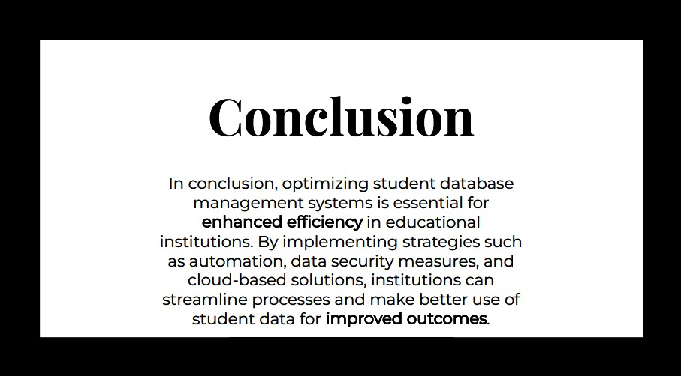

Slide 15


